Slide 1
Living at a Frontier Fort
National Park Service
U.S. Department of the Interior
Fort Larned National Historic Site
Life at Fort Larned

Slide 2
Brainstorming Questions:
What is a fort used for?
Who would live at a fort in the 1860’s?
What are some hardships or obstacles the people at the fort would have faced?
What were the ways people in the 1860’s would have:
Transported goods/travel
Communicated with one another
Heated or cooled their homes
Cooked their food
Obtained drinking water
Washed their clothes

Slide 3
Fort Larned National Historic Site

Slide 4
People of Fort Larned
National Park Service
U.S. Department of the Interior
Fort Larned National Historic Site
A Look at Those Who Called the Fort Home

Slide 5
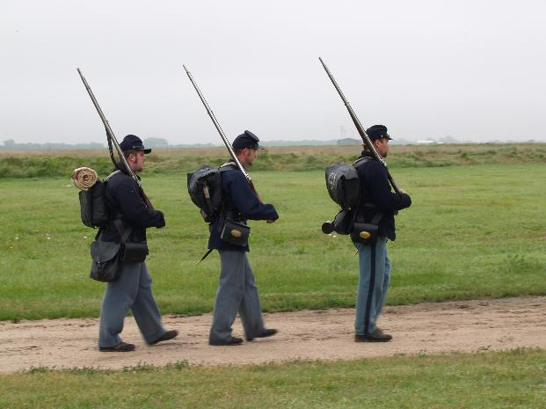
Infantry Soldiers
Most of the soldiers stationed at Fort Larned served in the infantry.
Infantry are foot soldiers, carrying their weapon and all supplies on foot.
Their duties included drilling, escorting wagon trains, guard duty, and cleaning.
Some even took turns cooking and working in the bakery.
They lived in cramped living conditions, even sharing a bed with another soldier.
They were paid about $13 per month.
Fort Larned Soldiers- 1867
Notes:
The bottom photo is a historic photo of Fort Larned soldiers in 1867

Slide 6
Cavalry
Cavalry soldiers fought on horseback.
They were ideal for fighting on the vast open areas of the Great Plains. Their speed on horseback allowed them to respond quickly to problems near the fort.
The cavalry’s horses were kept in a stable at the fort.
Both infantry and cavalry soldiers were known as enlisted men.

Slide 7
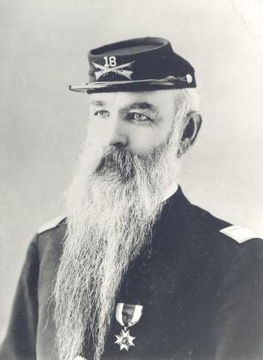
Officers
The officers were in charge of the enlisted men.
They were responsible for drilling, training and disciplining the enlisted men.
Most officers attended college.
They were provided better living quarters and pay than the enlisted men.
They were allowed to bring their wives and children with them.
Officers were required to purchase their own uniforms, food, and furnishings for their quarters.
Major John E. Yard Fort Larned Post Commander
1868-1869
Officer’s Row, 1879
Notes:
Top photo: Major John E. Yard, Fort Larned Post Commander: November 1, 1868- March 15, 1869
Bottom photo: 1879 photo of officer’s row at Fort Larned. The three houses on this row housed the commissioned officers.

Slide 8
Officers Wives
Leaving the “niceties” of the east, they followed their army husbands west with what few possessions could fit into a wagon.
Their role was behind the scenes. Usually the officer’s wives were in charge of entertaining, educating, and raising the children.
The wives had a huge impact on the fort because they brought a civilizing influence.

Slide 9
Laundresses
Some of the enlisted men’s wives served as laundresses.
Social standards in the 1860s prevented close relationships between officers’ wives and the other women on post.
They were in charge of washing the soldier’s laundry by hand.
There was one laundress for every 19 enlisted men. They received two dollars out of every soldier’s pay each month for their services, making their wages more than double that of an infantry soldier.
The laundresses were the only women at the fort recognized by the government as employees.

Slide 10
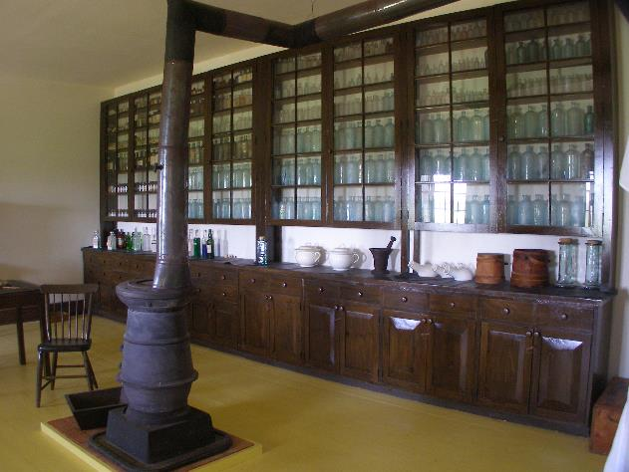
Post Surgeon
The post surgeon was an officer and lived in the officer’s quarters.
He provided treatment, including surgery, for the soldiers as well as civilians.
He also recorded the weather and other scientific data including plant and animal life around the fort.

Slide 11
Indian Agent
The Indian agent interacted with Native American tribes on behalf of the United States government.
He helped negotiate peace treaties and provided annuities, payments of money or supplies, to the tribes.
Edward Wynkoop
Indian Agent at Fort Larned
1866-1868
Notes:
Photo: Edward Wynkoop- Indian Agent at Fort Larned 1866-1868.

Slide 12
Commissary
The commissary was where the food rations from the army were issued to the enlisted men.
At best, the food supply at Fort Larned left a little to be desired.
Fresh vegetables and fruits were very rare. They were sometimes available in the sutler’s store.

Slide 13
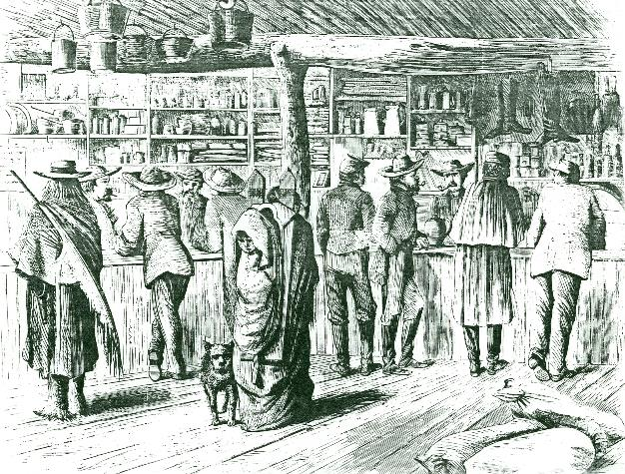
Sutler
The sutler was a civilian (not a member of the military) who sold items to the soldiers including food, tobacco, toothbrushes, candy, books, playing cards, pencils, papers, and other personal items.
Prices were high. They were set by the military.
He would also trade with local Native Americans and travelers along the Santa Fe Trail.
The sutler’s store was a popular place for the soldiers to gather and play games.
The store at Fort Larned even had a bowling alley!
Fort Larned Sutler Store

Slide 14
Quartermaster
This position was one of the most important on any frontier fort.
The quartermaster was in charge of all the army’s supplies, except food.
All uniform items, weapons, and other supplies were issued to the soldiers by the quartermaster.
He was also in charge of the construction and maintenance of the fort.
The quartermaster was responsible for hiring and supervising civilian employees, including carpenters, blacksmiths, clerks, interpreters, scouts and guides.

Slide 15
Civilians
In1868 the quartermaster at Fort Larned employed about 54 civilians doing various duties. Civilians are non-military personnel who usually specialize in a trade. Some of the civilian positions included:
Interpreters- a person who translated speech between the military and Native Americans. They were paid up to $100 per month.
Scouts- patrolled the area around the fort to keep an eye on the movement of the Native Americas. Most scouts were from other Native Americans tribes themselves. They were paid about $75 per month.
Blacksmiths- made nails, horseshoes, and wagon pieces. They heated wrought (raw) iron and used tools such as a hammer and anvil to bend and shape the iron. They were paid about $85 per month.
Carpenters- built and maintained the fort’s structures. Carpenters also maintained many of the wooden wagon pieces for the military. They were paid about $85 per month.
Wheelwrights- built and repaired the wooden wagon wheels. They were paid about $85 per month.
Teamsters- a person who drove a team, usually of oxen or mules, pulling a military wagon. Teamsters were responsible for shipping most military supplies. They were paid about $25 per month

Slide 16
Questions:
What roles did women play at the fort?
How many laundresses would a company of 76 soldiers require?
What foods would you like to be on the commissary list?
Which civilian earned the highest pay? Why do you think that is?
What job would you want at the fort? Why?

Slide 17
1860s vs 2020s Living
National Park Service
U.S. Department of the Interior
Fort Larned National Historic Site
Life at a Frontier Fort

Slide 18
Transporting Goods
1860s
2020s
All goods were transported along dirt paths by teams of wagons pulled by mules, horses, and oxen.
Goods today are transported much faster today by trucks, planes, and ships.
Notes:
2020 photo source: pexels.com

Slide 19
Communication
1860s
2020s
Music has long been used in the military to relay commands or pass calls, both in the field and in camp. Drums and bugles were used for this purpose. Soldiers would send handwritten letters home (although many could not read or write).
Today we primarily use smart phones, texting, email, and messaging apps to communicate. Most letters today are typed instead of handwritten.
Notes:
2020 photo source: pexels.com

Slide 20
Heating and Cooling
1860s
2020s
Many modern houses have a central heating and/or cooling system. Some use wood or coal stoves for heat.
Heating was provided by wood or coal stoves and fireplaces. There was a stove/fireplace in every room. To heat a whole house, one would have to man several fires. Opening the windows was the only way to provide cooling in the summer.
Notes:
2020 photo source: publicdomainpictures.net

Slide 21
Cooking
1860s
2020s
Food was cooked on a wood or coal fired stove. There was a very little variety of ingredients. There were no refrigerators to keep food cold. Fort Larned used ice boxes, filled with ice block cut from the river, to keep food cold.
Today we use electric or gas stoves, ovens, microwaves, air fryers, and more to cook. A wide variety of food ingredients can be purchased at the grocery store. Cold items are kept in a refrigerator.
Notes:
2020 photo source: pexels.com

Slide 22
Water
1860s
2020s
Houses today are connected a city water supply or well. Piping runs through the house to provide water at faucets. Bathrooms are all indoors.
Water was obtained from the river or by lowering a bucket into a hand dug well. There was no indoor plumbing. Outside outhouses served as toilets.
Notes:
2020 photo source: pexels.com

Slide 23
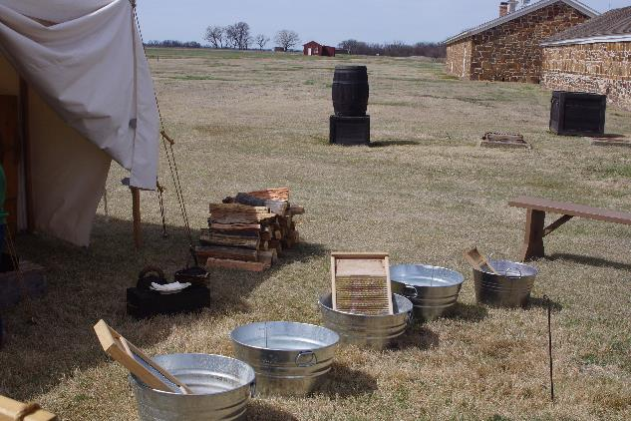
Washing Clothes
1860s
2020s
Laundry was washed by hand using tubs and washboards. All water would have to be brought in by bucket from the well or river. Water was heated by placing the wash tub above a fire. Clothes were hung to dry.
Today we use washing machines to clean our clothes and dryers to dry them. Water is heated by an indoor water heater.
Notes:
2020 photo source: pexels.com

Slide 24
Assignment
Imagine you are based at Fort Larned in the 1860s. Write a letter back home describing your life at the Fort. Be sure to mention:
What position do you hold at the fort?
What duties do you perform?
What is your daily life like at the fort?
What do you like about life at the fort?
What do you dislike about life at the fort?

Slide 25
Fort Larned National Historic Site

Slide 26
National Park Service
U.S. Department of the Interior

